Slide 1
ASP.NET MVC Bootcamp
Umbraco Codegarden 2010

Slide 2
Hi
Jon Galloway
@jongalloway
jon.galloway@microsoft.com
http://weblogs.asp.net/jgalloway (blog)
http://herdingcode.com (podcast)
ASP.NET Community Program Manager
ASP.NET Developer (like you)

Slide 3
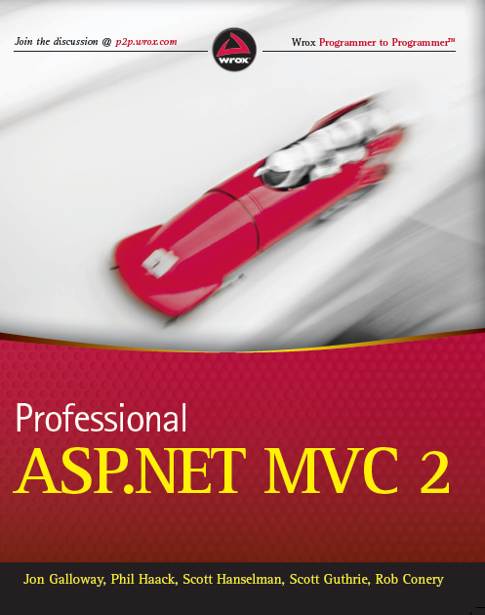

Slide 4
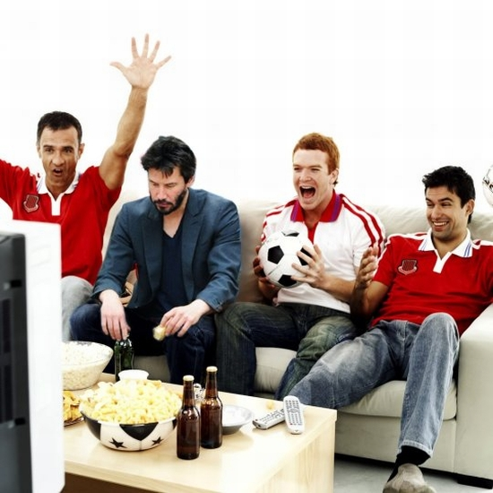
Are you in the right place?

Slide 5
 | The main hall | The Back room
8:00 | Registration
9:00 | ASP.NET MVC Bootcamp | Intermediate ASP.NET MVC
10:00 | ASP.NET MVC Bootcamp | Extending ASP.NET MVC part 1
11:00 | Hands on / lab
11:45 | Lunch
12:45 | ASP.NET MVC Bootcamp | Extending ASP.NET MVC part 2
13:45 | ASP.NET MVC Bootcamp | Beyond Test Driven Development
14:45 | Hands on / lab
15:30 | ASP.NET MVC Web Security | TBA
16:30 | Panel and Q/A

Slide 6
Agenda
9:00 – 9:50 | Introduction to MVC
10:00 – 10:50 | Data
11:00 – 11:45 | Labs
11:45 – 12:45 | Lunch
12:45 – 13:30 | Forms and validation
13:45 – 14:45 | Advanced
14:45 – 15:30 | Labs

Slide 7
Introduction to ASP.NET MVC

Slide 8
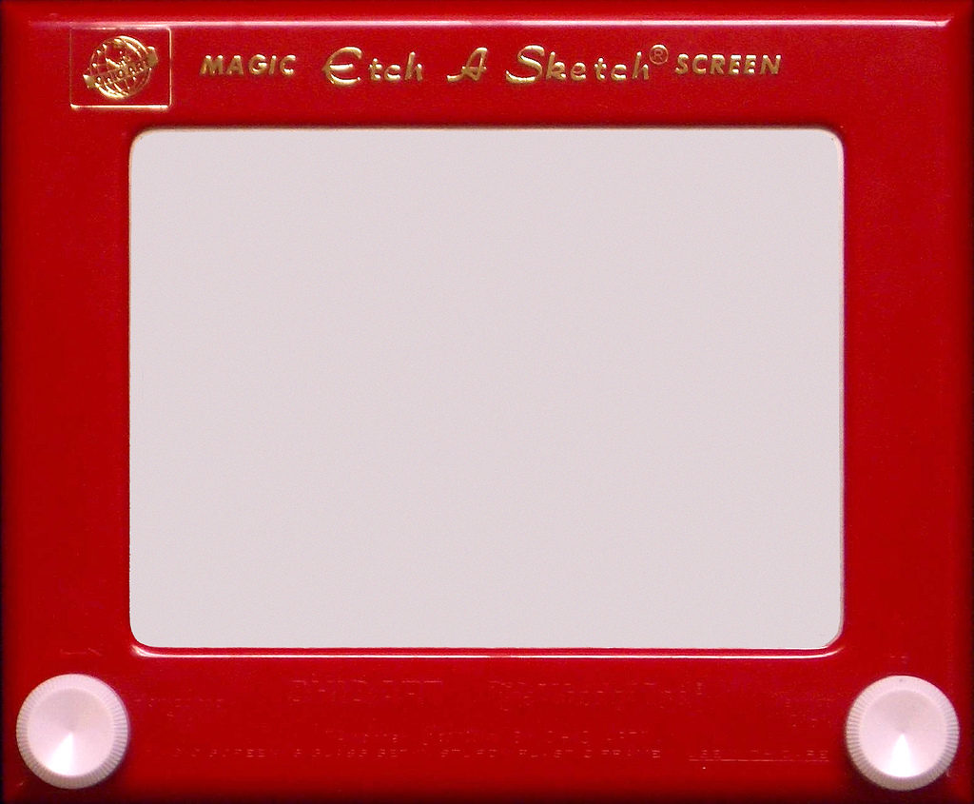
Not starting over…
Notes:
http://www.flickr.com/photos/fimoculous/3210330182/sizes/l/

Slide 9

Notes:
http://www.sxc.hu/photo/1233419

Slide 10
ASP.NET Core
Caching
Modules
Globalization
Pages
Controls
Master Pages
Profile
Roles
Membership
Intrinsics
Handlers
etc.

Slide 11
Web Forms
MVC
ASP.NET Core
.NET Runtime

Slide 12
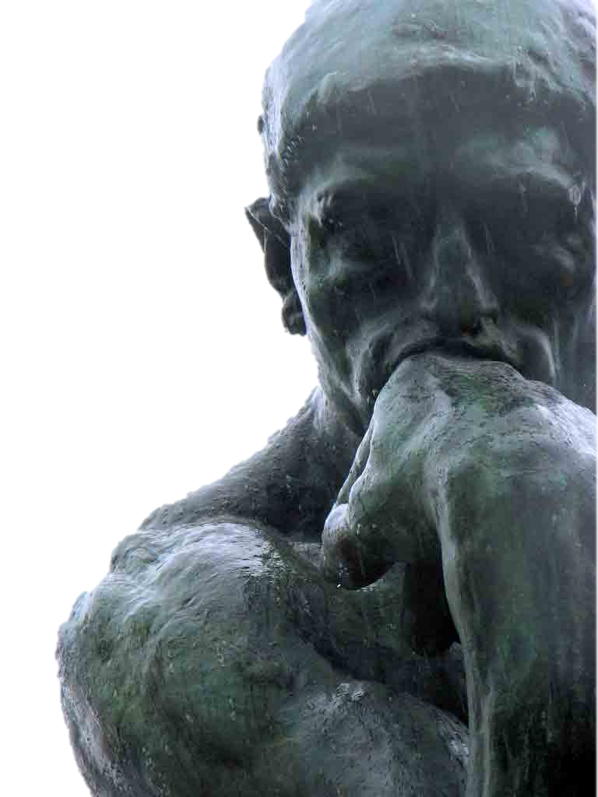
Why?

Slide 13
ASP.NET Web Forms Values
Productive way to build web applications
Control and event-based programming model
Controls that abstract HTML, JS and CSS
Rich UI controls – datagrids, charts, Ajax
Browser differences are handled for you
Summary: Web Forms handles a lot of things for you.

Slide 14
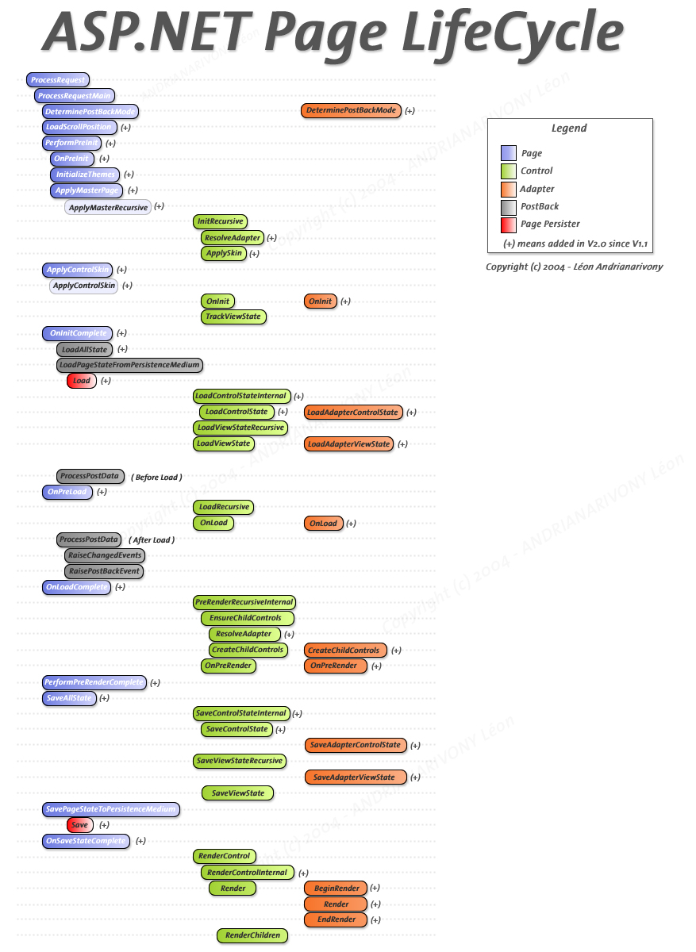

Slide 15
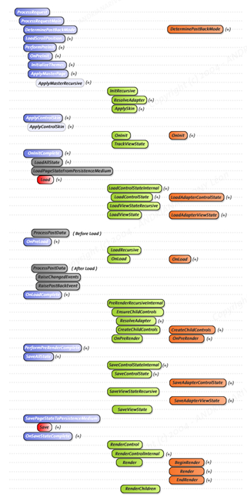
Default.aspx

Slide 16
Default.aspx
Products.aspx
About.aspx

Slide 17
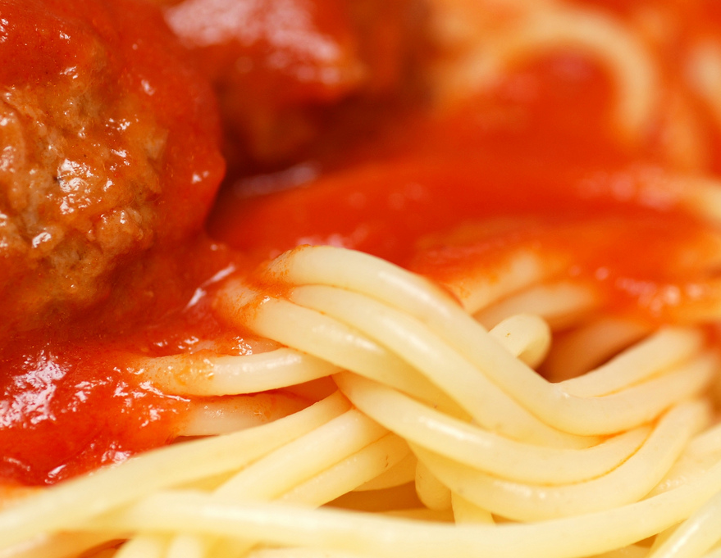
Hard to avoid
spaghetti code,
spaghetti projects
Notes:
http://www.flickr.com/photos/picsbycam/3787124260/

Slide 18
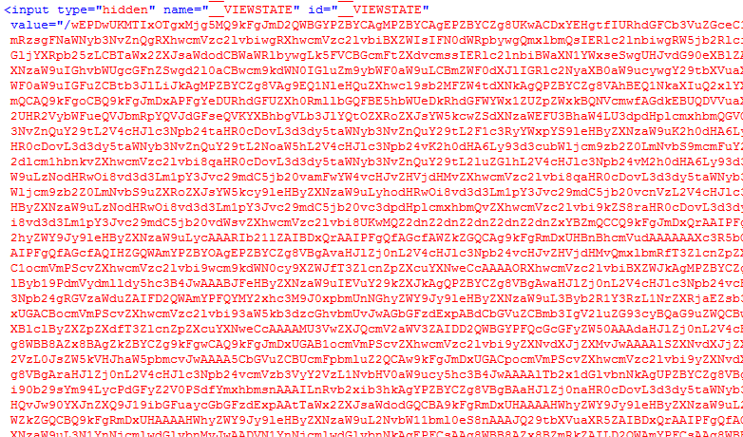
Viewstate

Slide 19
<select name="ctl00$uxLanguageSelector$uxLanguageSelector" onchange="javascript:setTimeout('__doPostBack(\'ctl00$uxLanguageSelector$uxLanguageSelector\',\'\')', 0)" id="ctl00_uxLanguageSelector_uxLanguageSelector" class="countrySelect">

Slide 20

Notes:
http://www.sxc.hu/photo/492545

Slide 21
Let’s be fair
ASP.NET 4 Web Forms improves these a bit…

Slide 22
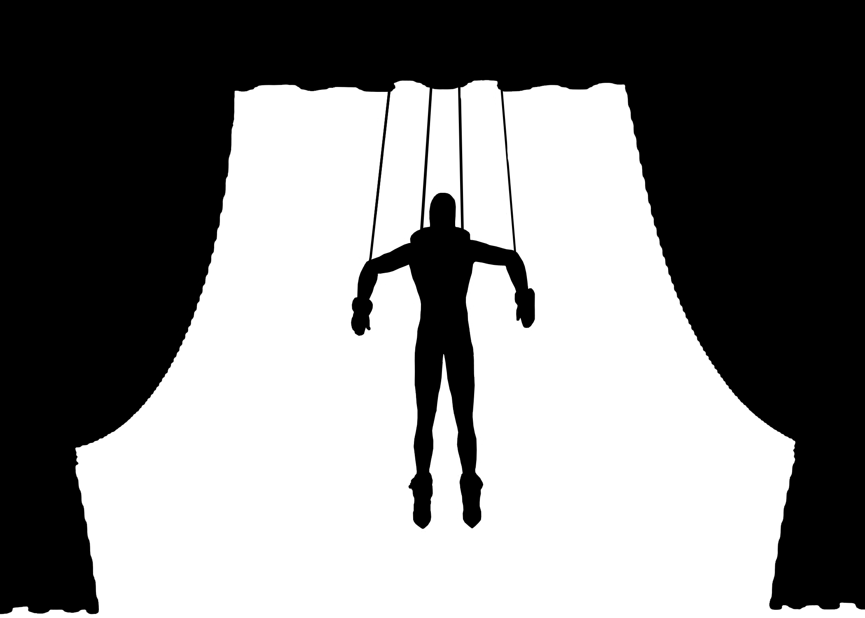
Notes:
http://www.sxc.hu/photo/1064377

Slide 23
ASP.NET MVC Values
Easy to build, develop and maintain web apps
Simple to extend and customize
Encourages a clean and robust architecture

Slide 24
ASP.NET MVC 101
Controller
(Logic)
View
(Presentation)
Model
(Data)
Notes:
Estimated Time: 2 minutes
MVC is a design pattern that stands for Model-View-Controller. What is strives to do is separate the concerns of an application’s presentation layer by assigning specific roles to the three different components.
The Controller is responsible for handling all user input. Once input has been received, the Controller will perform any operations/actions it needs to, which might include interacting with the Model.
The Model represents the data in the application. Once the Controller retrieves some model data and performs any work with the model/etc it needs to it constructs a presentation model that describes the model in terms the View can understand.
The View is the visual representation of the model. It presents the model data to the actual user in a way that is meaningful. In a web application, this would typically be HTML.

Slide 25



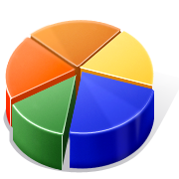
How MVC Works
What does MVC look like?
Request
Controller
Controller
Retrieves Model
“Does Stuff”
View
View
Visually represents
the model
Response
Notes:
Estimated Time: 4 minutes
So what does MVC look like when implemented over the web?
When an HTTP request comes into the application it is mapped to a controller. Remember as we mentioned in the previous slide, in the MVC design pattern, the controller is the piece of the trifecta that handles all user input. In the case of a web application, user input is represented as HTTP requests [Advance Animation].
Once the controller has received input, it performs whatever operations it needs to and then assembles a presentation model [Advance Animation].
The controller then takes the model and passes it off to the view. Remember that the view is simply a visual representation of the model [Advance Animation].
The view then “transforms” the model into whatever format it uses to represent it. In a web application, this would typically be HTML [Advance Animation].
The view then serves the request by responding with its visual representation.

Slide 26

Models
Controller
View
The models hold the application data
Models are the mean of communication between the controllers and the views
Models hold no application logic
Notes:
Estimated Time: 2 minutes
Let’s first start by the M (of MVC), the Models.
Models are the mean of communication between the controllers and the views. Whenever a controller processes a request from the user and has to display information, it creates the model and passes it to the view.
The model only holds data. It doesn’t know anything about the application logic or how to display itself.

Slide 27
Views
View
Views are visual representations of a model
There can be many views for the same model
Views contain no application logic
Notes:
Estimated Time: 2 minutes
Now let’s continue with the V (from MVC), the Views.
Views are visual representations of the models. They are responsible for displaying a model or part of it to the user. The views don’t hold application logic.
Note that there can be many views of the same model. Maybe one view displays the name and address of a customer while other displays the telephone and the orders from that same customer but both rely on the same model: the customer.

Slide 28
Controllers
Request
Controller
View
Controllers handle requests from the user
Controllers create the model for the views
Application logic is placed in the controllers
Notes:
Estimated Time: 2 minutes
Finally, we got to the C (from MVC), the Controllers.
Controllers are responsible of receiving user requests and taking care of them accordingly. In general, controllers would create a model, which they fill with data from a persistence source like a database and pass it to a view.

Slide 29
Routing
http://site.com/product/details/5
Controller
Parameter
Action
ProductController.Details(5)

Slide 30
ASP.NET MVC Basics
Demo
Notes:
Crib - 002a – Creating a new ASP.NET MVC Application – Demo Script
Demo Time: 10 mins
File > New
Talk about testing, but don’t create a test project
Structure of an MVC project
Create ActivitiesController and run app, browse to /Activities/
Show error, talk about what it means
Show Routing in Global.asax
Create View
Create Activity class w/ Name and DateOpened
BUILD
Add new ActivitiesController.Details
Add Details Controller action
Return Activity, populated via class initializers
Add a new view w/ Details template
Display
<%: encoding syntax

